Slide 1
Energy through the Ecosystems
Unit 6

Slide 2
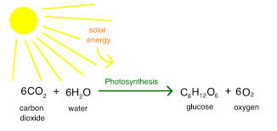
What is photosynthesis? The Process by which plants get their energy From the sun
Where? Inside the chloroplast.. Filled with chlorophyll (Green pigment)
What’s needed: sunlight, Carbon Dioxide(CO2), Water(H2O)
What’s produced: Carbohydrates/Sugar (C6H12O6) and Oxygen (O2)

Slide 3
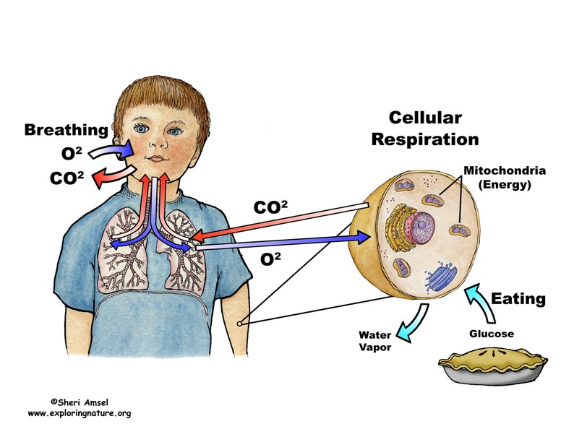
What is Cellular Respiration? The process by which animals get their energy from food
Where? Mitochondria: energy storage of all cells
What’s needed: Carbohydrates/Sugar (C6H12O6) and Oxygen (O2)
What’s produced: Energy, Carbon Dioxide(CO2), Water(H2O)

Slide 4
What do You notice?
How do these processes compare/contrast

Slide 5
Opposites!!
Cellular respiration
Photosynthesis

Slide 6
What other cycles in nature exist?

Slide 7
What other cycles in nature exist?
Water cycle
Water usage/pollution … https://youtu.be/VrzbRZn5Ed4
Carbon Cycle
Nitrogen Cycle

Slide 8
Reinforcement
https://www.brainpop.com/science/cellularlifeandgenetics/photosynthesis/
https://www.brainpop.com/science/cellularlifeandgenetics/metabolism/

Slide 9
Water Cycle Review

Slide 10
Key Terms
Condensation: Water vapor condensing into solid (cloud)
Evaporation: Liquid water heating up and rising in the form of water vapor
“Evapo”Transpiration: Liquid evaporating from within a plant (plant sweat)
Precipitation: Condensation heavy enough to fall in the form of rain snow sleet or hail
Run Off: Water that flows from higher elevation to lower elevation
Sublimation: Solid water to gas
Ground Water: Water … in the ground :/
Infiltration: Water that “filters” into the ground

Slide 11
H2O Post Cards
Rubric/examples
Template

Slide 12
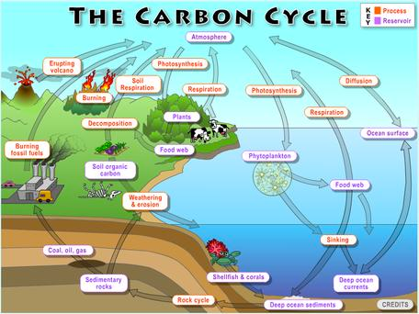
Carbon Cycle
Carbon moves through organisms and the physical environment
Organisms
Photosynthesis
Cellular Respiration
Land
Ocean carbon “sink”
Decomposition
Air
Fossil Fuel usage
Combustion

Slide 13
Carbon Cycle
Carbon moves through organisms and the physical environment
How does carbon enter and exit animals?
What has caused carbon dioxide levels to rise in the last 100 years?

Slide 14
Crash course… carbon and hydro cycle
https://youtu.be/2D7hZpIYlCA
https://youtu.be/Eq9ReZ7jH4U study jams
https://www.brainpop.com/science/earthsystem/watercycle/
https://www.brainpop.com/science/earthsystem/carboncycle/

Slide 15
Nitrogen Cycle
The movement of Nitrogen between the environment and living things
Air: 78% Nitrogen.. Unusable by animals
Nitrogen fixation #1: when bacteria in soil are able to change nitrogen gas into forms that plants can use
Nitrogen Fixation #2: Lightning can also cause nitrogen gas to be changed into usable nitrogen in the soil.
Death: Dead organisms release nitrogen in the soil
Denitrifying: Bacteria can change Nitrogen back into gas form.

Slide 16
Nitrogen Cycle
The movement of Nitrogen between the environment and living things
_________ is the process by which bacteria turns nitrogen gas into composite that plants can use.
__________ is a term that describes nitrogen returning to the atmosphere as a gas.

Slide 17
Crash Course Nitrogen Cycle
https://youtu.be/leHy-Y_8nRs
https://youtu.be/xfwZV6rtnvw study jams
https://www.brainpop.com/science/earthsystem/nitrogencycle/

